Slide 1

Student Ambassador Projects
Ambassador Projects Final Deck
Notes:
Korrie

Slide 2
SpamBuster Solution Type: AI Core
Amit Kumar
Notes:
Korrie

Slide 3
The Opportunity
The Growing Threat of Spam
Exponential Increase: Spam emails and SMS have been increasing at an alarming rate. According to recent studies, over 50% of global email traffic is spam.
Economic Impact: Spam costs businesses billions of dollars annually in lost productivity and cybersecurity measures.
Personal Harm: Individuals are frequently targeted by phishing scams, leading to identity theft, financial loss, and emotional distress.
Evolving Tactics: Spammers continuously evolve their tactics, making it harder to detect and block spam using traditional methods.
The Role of AI/ML in Combating Spam
Emerging Technologies: AI and Machine Learning are at the forefront of technological advancements, offering powerful tools to combat spam.
Automated Detection: AI/ML models can analyze vast amounts of data to identify patterns and anomalies that signify spam.
Real-Time Filtering: Machine learning algorithms can be deployed to filter spam in real-time, providing immediate protection.
Adaptive Learning: AI systems can adapt to new spam tactics by learning from new data, ensuring continuous improvement in spam detection.
Notes:
Korrie
updated 7/21

Slide 4
Solution
SpamBuster
SpamBuster utilizes state-of-the-art natural language processing (NLP) and machine learning algorithms to accurately classify emails and SMS as spam or not spam.
How SpamBuster Works
Text Preprocessing: Messages are cleaned and normalized using NLP techniques to remove noise and standardize the text.
Feature Extraction: Important features are extracted from the text using techniques like TF-IDF vectorization.
Model Prediction: The processed text is fed into a machine learning model to predict whether the message is spam or not.
User Interface: A user-friendly interface built with Streamlit allows users to input messages and receive real-time classification results.
Leveraging Azure ML Studio
Scalability: Azure ML Studio provides a scalable platform to deploy and manage machine learning models, ensuring SpamBuster can handle large volumes of data.
Integration: Seamlessly integrates with other Azure services, enabling robust data pipelines and efficient model training.
Monitoring and Management: Azure ML Studio offers tools for monitoring model performance and retraining models as needed, ensuring SpamBuster remains effective against evolving spam tactics.
Notes:
Korrie
updated 7/21

Slide 5
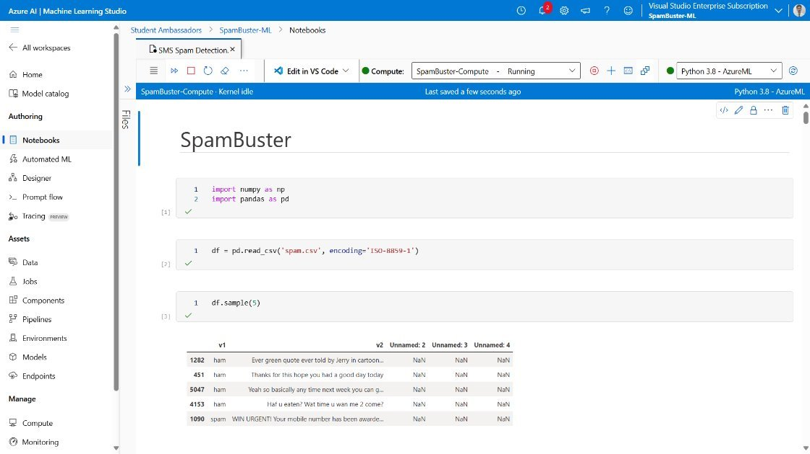
Demo
Notes:
Korrie
updated 7/21

Slide 6
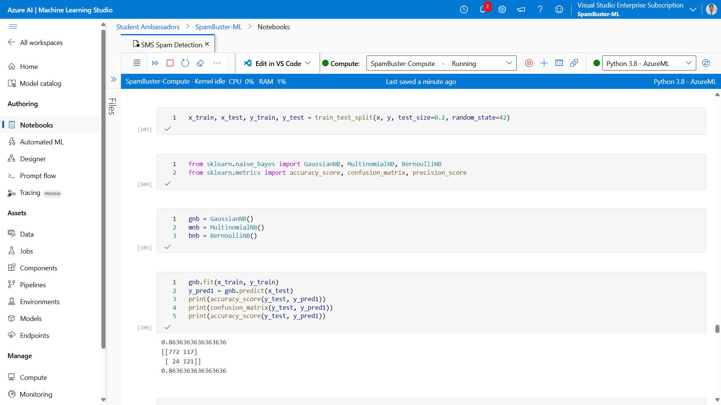
Demo
Notes:
Korrie
updated 7/21

Slide 7
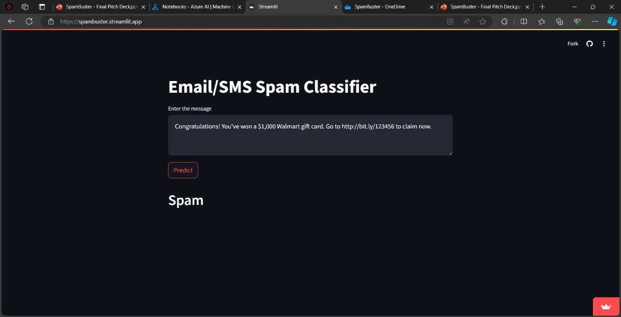
Demo
Notes:
Korrie
updated 7/21

Slide 8
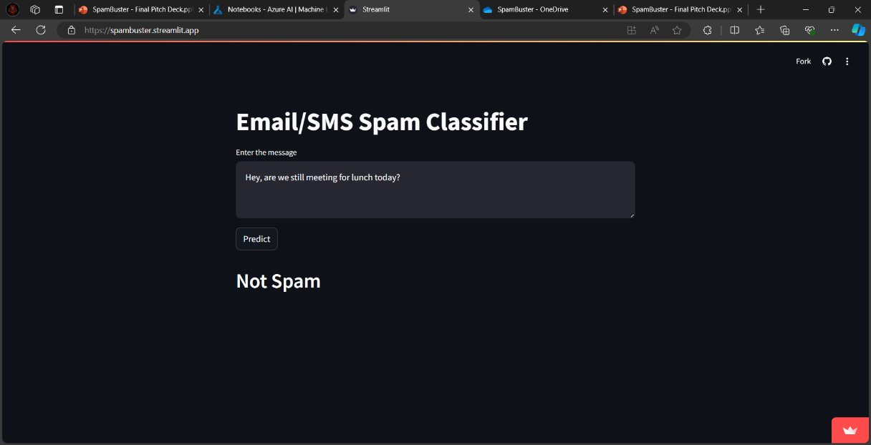
Demo
Notes:
Korrie
updated 7/21

Slide 9
Takeaways
People should be aware of the risks of spam and act intelligently to avoid any losses.
AI/ML is far more efficient for these type of tasks. These models provide higher accuracy in detecting spam compared to traditional rule-based methods.
Machine learning algorithms adapt to new spam tactics, ensuring ongoing protection.
AI/ML solutions can handle large volumes of data, making them suitable for both individual and enterprise use.
Azure provides services like ML Studio which makes this very organized, scalable, managable and cheaper.
Notes:
Korrie
updated 7/21

